Slide 1
Interactive Terabytes with pbdR
Wei-Chen Chen, Drew Schmidt, and
George Ostrouchov
pbdR Core Team
http://r-pbd.org

Slide 2

Disclaimer
The findings and conclusions in this presentation have not been formally disseminated by the U.S. Department of Health & Human Services nor by the U.S. Department of Energy, and should not be construed to represent any determination or policy of University, Agency, Administration and National Laboratory.

Slide 3
Acknowledgement
Support:
This work was supported in part by the project ``Harnessing Scalable Libraries for Statistical Computing on Modern Architectures and Bringing Statistics to Large Scale Computing’’ funded by the National Science Foundation Division of Mathematical Sciences under Grant No. 1418195.
This work used resources supported by the National Science Foundation under Grant Number 1137097 and by the University of Tennessee through the Beacon Project.

Slide 4
Outlines
Two text based client/server applications
Demonstrations of pbdR client/server
one pbdR client with one pbdR server
pbdZMQ + remoter (+ getPass + sodium)
Introduction
Implementations for HPC
Demonstrations of pbdR clusters
one pbdR client with pbdR clusters in SPMD
pbdZMQ + remoter + pbdCS (+ getPass + sodium) + pbdR’s packages
Discussions

Slide 5
Two text based client/server applications

Slide 6
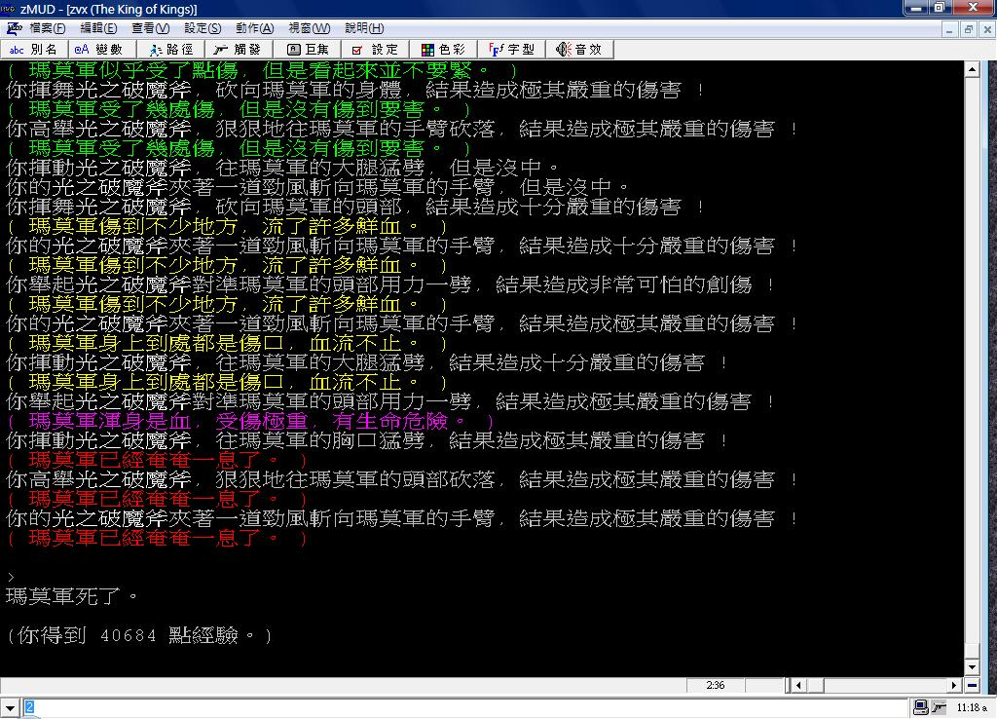
MMORPG MUD
A client/server game (King Of Kings, 1996)
(https://zh.wikipedia.org/wiki/File:KK_MUD.jpg)

Slide 7
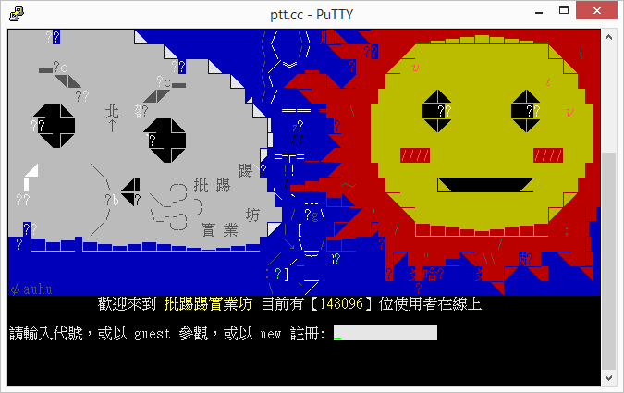
Bulletin Board System
A client/server BBS (telnet://ptt.cc, 1995)
over 150,000 users online during peak hours

Slide 8
Demonstration of pbdR client/server https://github.com/snoweye/user2016.demo

Slide 9
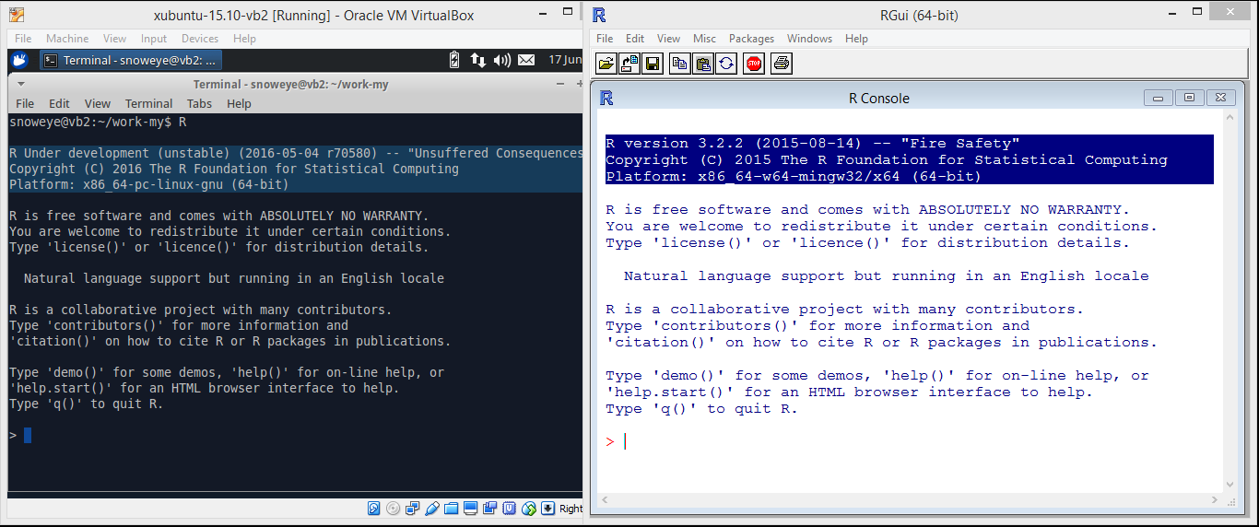
pbdZMQ + remoter
server/remote
guest OS: Xubuntu-15.10
R-devel r70580 (64-bit)
client/local
host OS: Microsoft Windows 8
R 3.2.2 (64-bit)

Slide 10
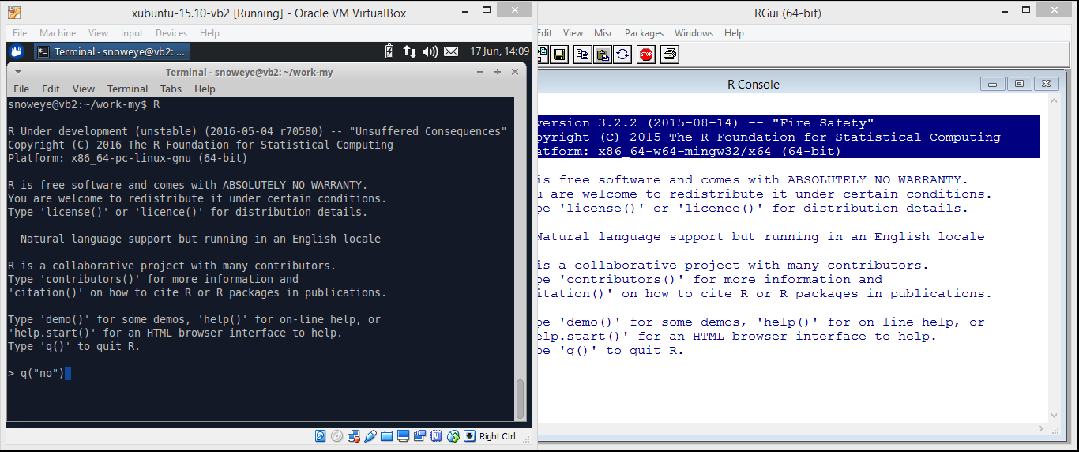
pbdZMQ + remoter
server/remote
just normally quit R
go back to command line
client/local
do nothing

Slide 11

pbdZMQ + remoter
server/remote
use `ifconfig` to obtain ip address
client/local
do nothing

Slide 12
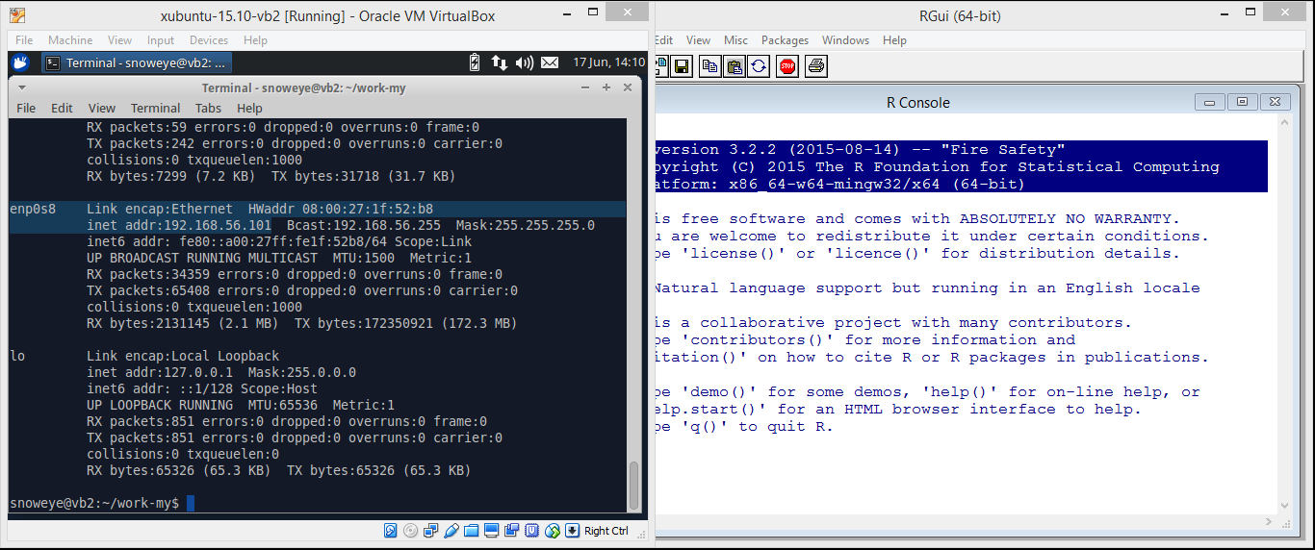
pbdZMQ + remoter
server/remote
guest OS has a host-only adapter
ip: 192.168.56.101
client/local
do nothing

Slide 13

pbdZMQ + remoter
server/remote
launch remote R server
with password protection
password: pbdr
client/local
do nothing

Slide 14
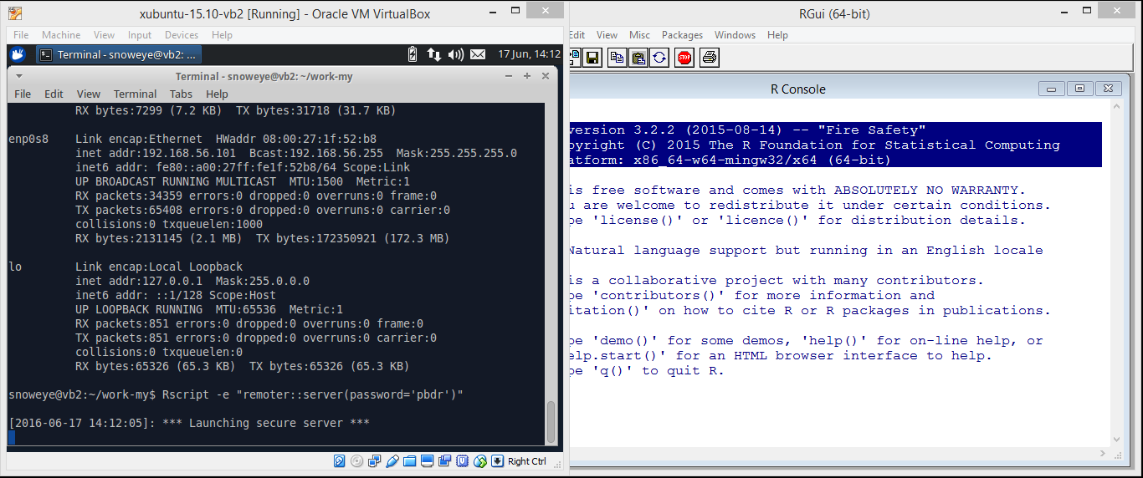
pbdZMQ + remoter
server/remote
remoter server is on
client/local
do nothing

Slide 15
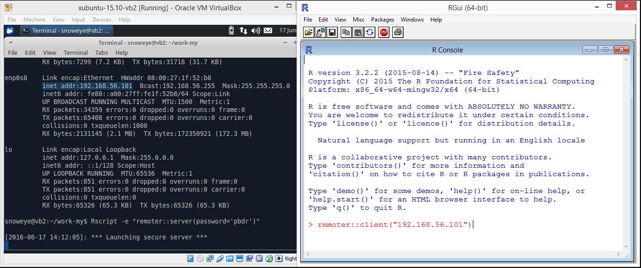
pbdZMQ + remoter
server/remote
server is waiting
client/local
connect to server

Slide 16
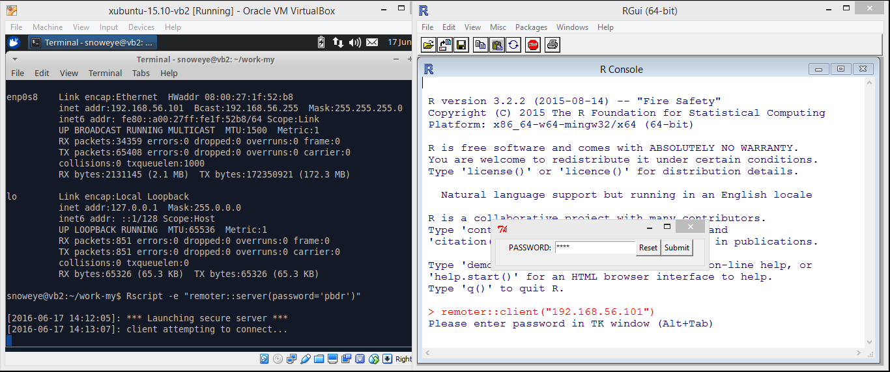
pbdZMQ + remoter
server/remote
remoter server responses requests
client/local
enter password (masked)

Slide 17
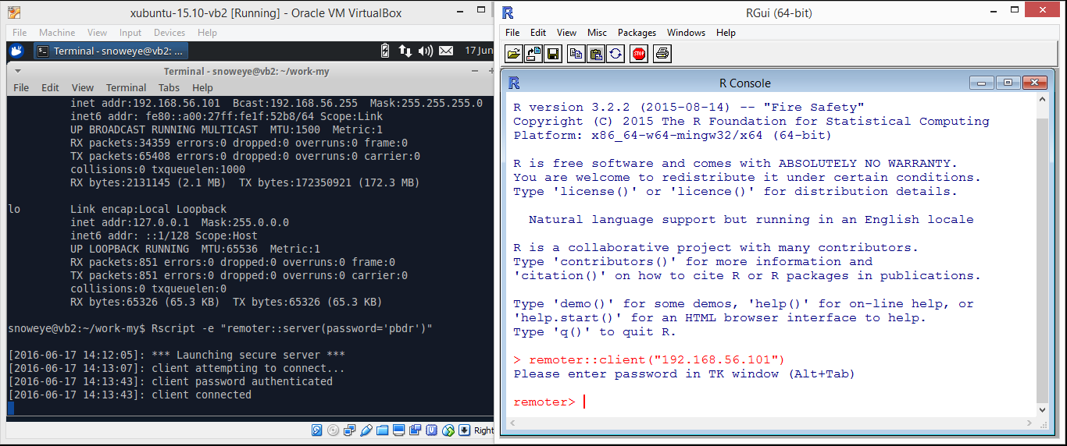
pbdZMQ + remoter
server/remote
check the password
connect the client
client/local
start remote R
connect to the server
everything is on the sever from now on

Slide 18
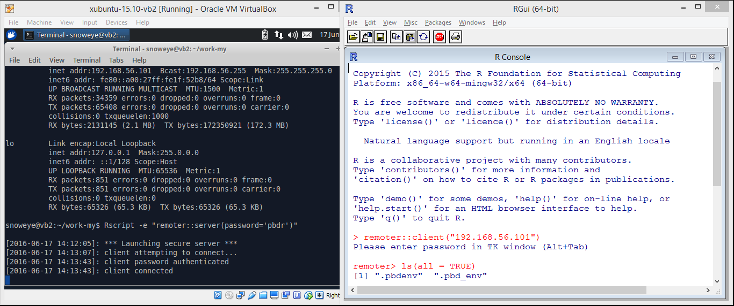
pbdZMQ + remoter
server/remote
executing client’s commands
client/local
check what is on server

Slide 19
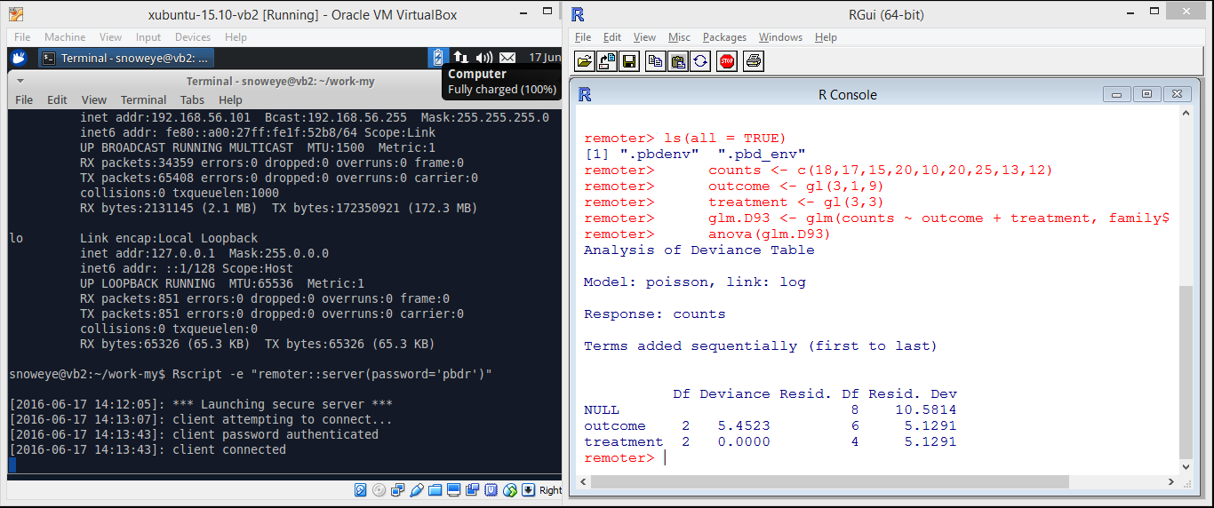
pbdZMQ + remoter
server/remote
receive, execute, and return client’s commands
log message is disabled
client/local
run `stats::glm()` example taken from `help(“glm”)`
run `stats::anova()` on the GLM model fit

Slide 20
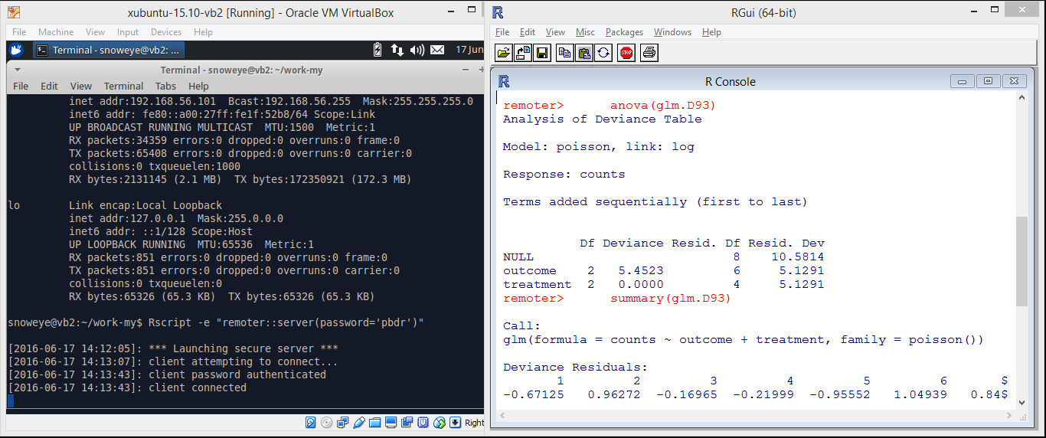
pbdZMQ + remoter
server/remote
receive, execute, and return client’s commands
log message is disabled
client/local
run `base::summary()` on the GLM model fit

Slide 21
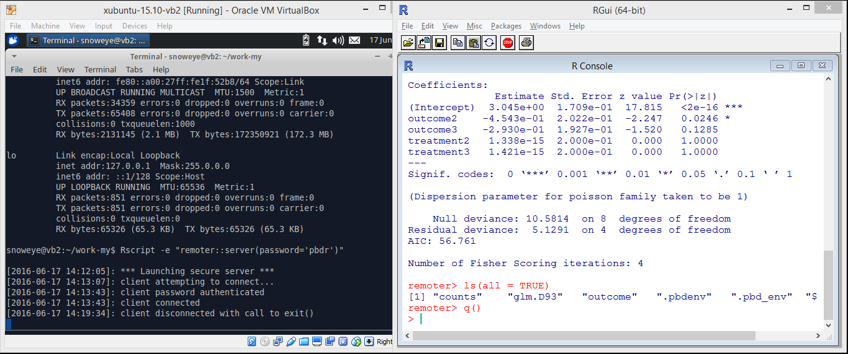
pbdZMQ + remoter
server/remote
disconnect the client
remoter server is still alive
client/local
check what are on server
done and quit, really!

Slide 22
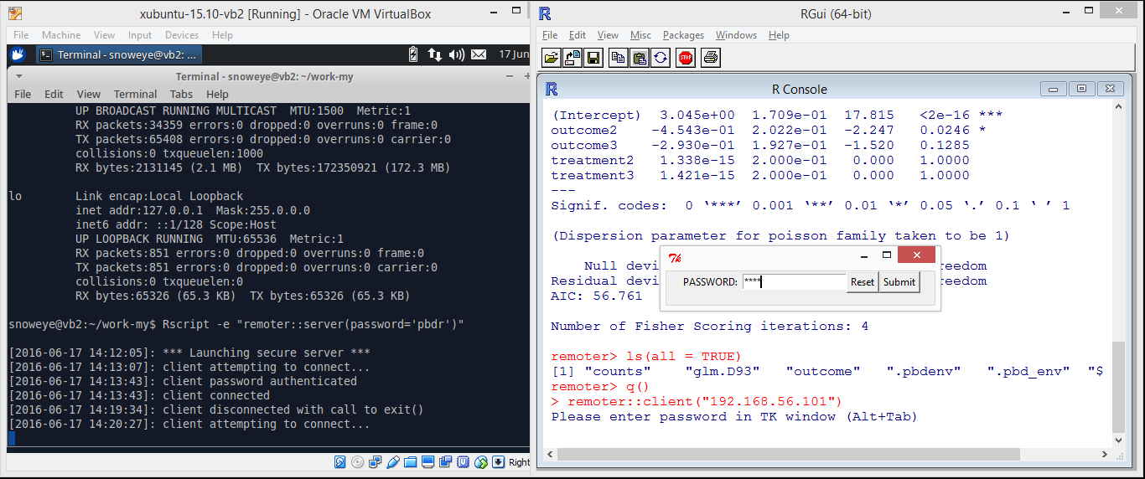
pbdZMQ + remoter
server/remote
the other client coming in
client/local
how about reconnect again?

Slide 23
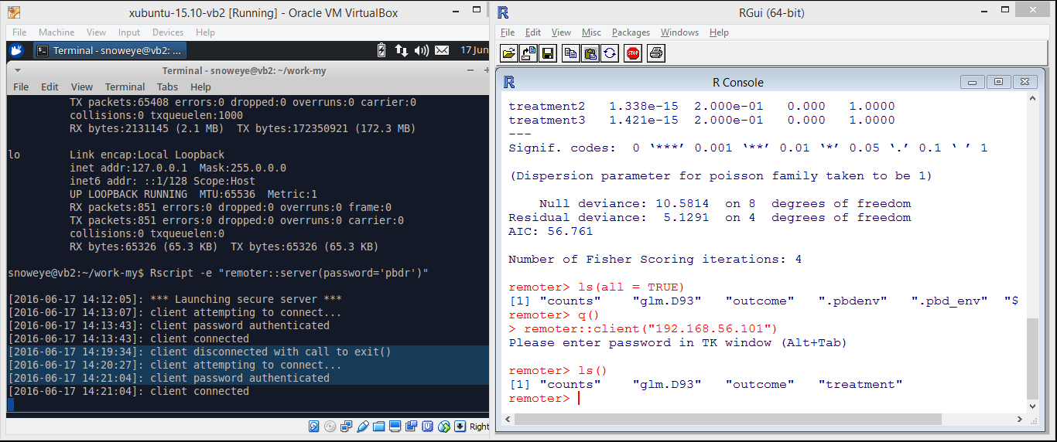
pbdZMQ + remoter
server/remote
server is on
the client is reconnected
client/local
check if data are still there

Slide 24
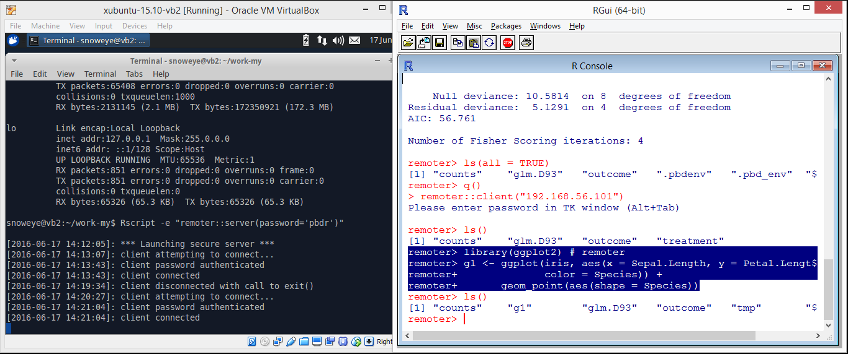
pbdZMQ + remoter
server/remote
receive, execute, and return client’s commands
log message is disabled
client/local
how about to have some plots?
load `ggplot2`
run an `iris` example

Slide 25
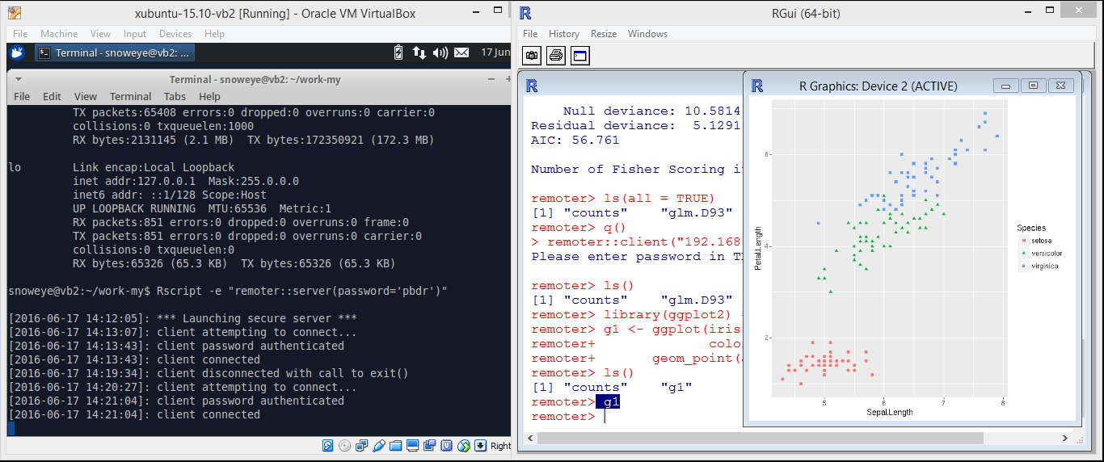
pbdZMQ + remoter
server/remote
receive, execute, and return client’s commands
log message is disabled
client/local
data are on server
only image is got from the server
print the image locally

Slide 26
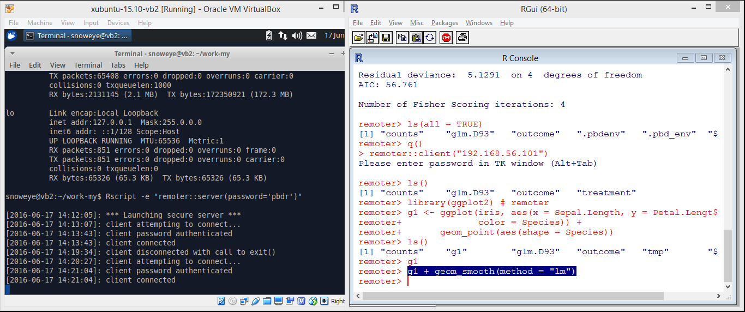
pbdZMQ + remoter
server/remote
receive, execute, and return client’s commands
log message is disabled
client/local
how about directly update the `ggplot` object?

Slide 27
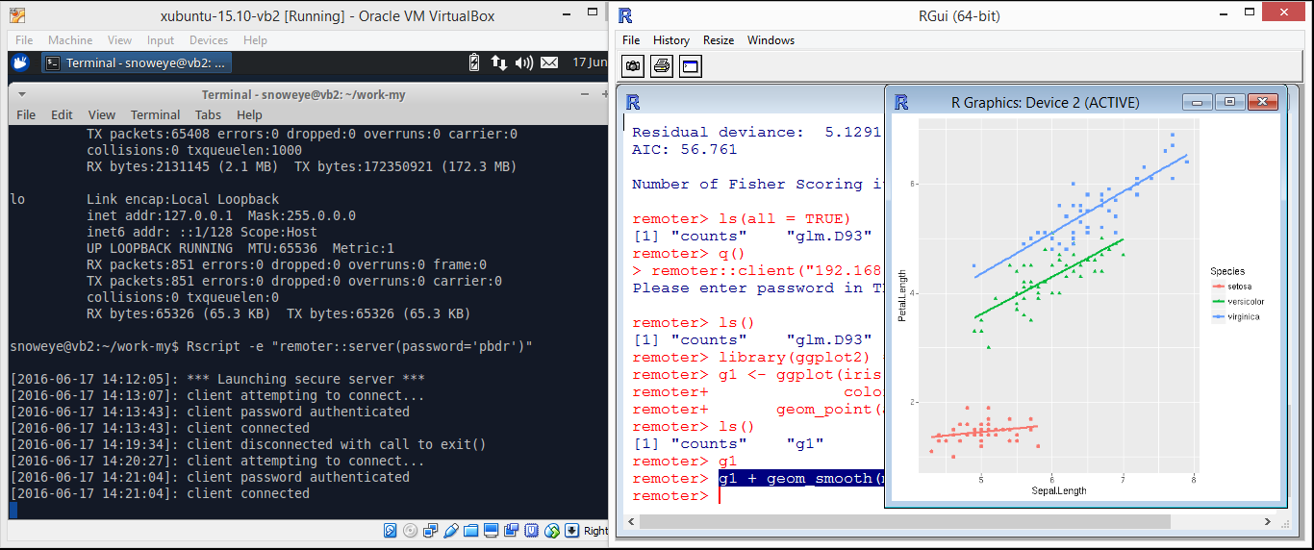
pbdZMQ + remoter
server/remote
receive, execute, and return client’s commands
log message is disabled
client/local
yes, regression lines are added

Slide 28
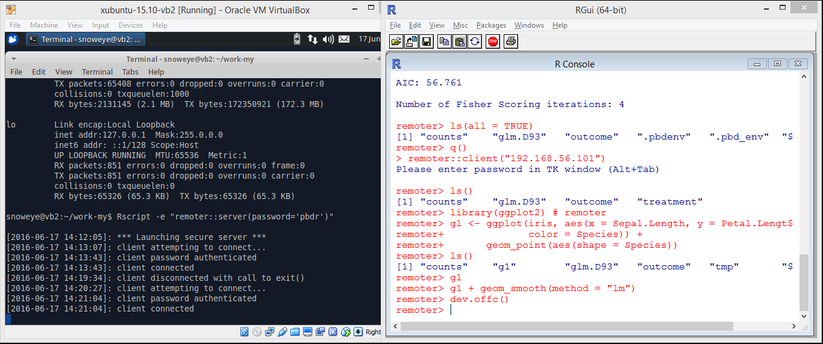
pbdZMQ + remoter
server/remote
receive, execute, and return client’s commands
log message is disabled
client/local
close the remoter graphic device via `dev.offc()` locally

Slide 29
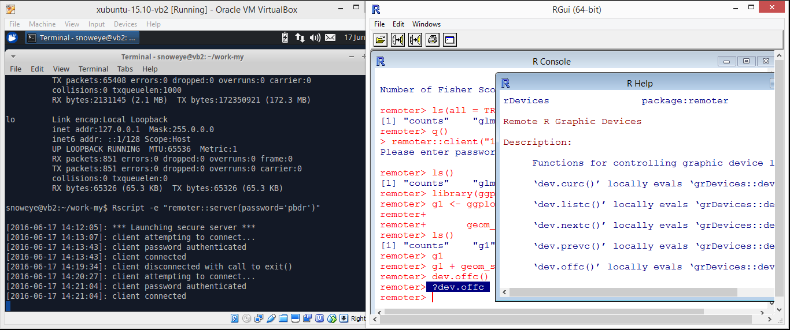
pbdZMQ + remoter
server/remote
receive, execute, and return client’s commands
log message is disabled
client/local
what is `dev.offc()`?
this help page is sent from server!!!

Slide 30
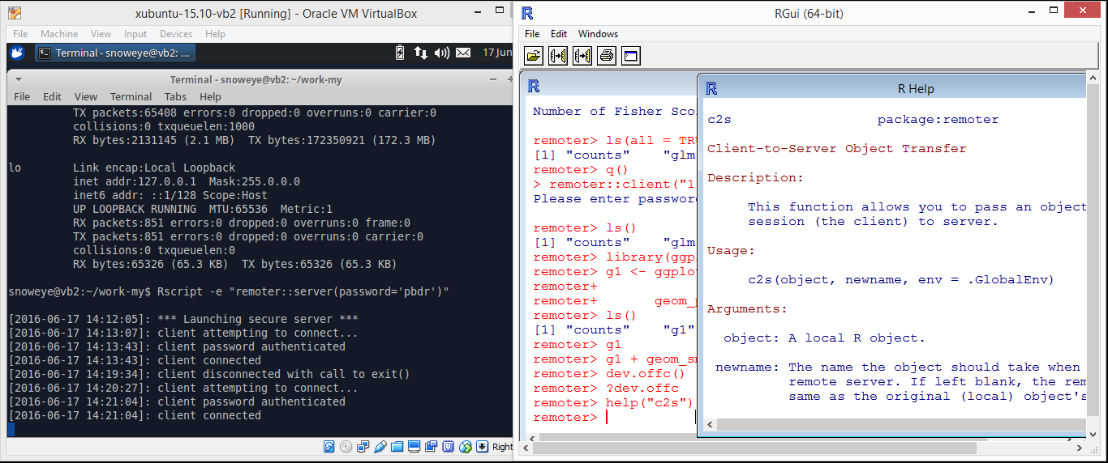
pbdZMQ + remoter
server/remote
receive, execute, and return client’s commands
log message is disabled
client/local
how about copy a local R object to the server/remote?
this help page is also sent from server

Slide 31
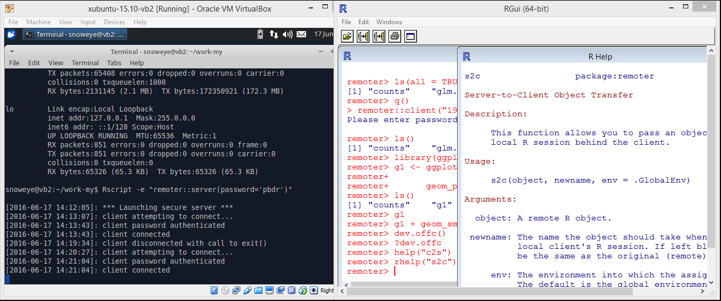
pbdZMQ + remoter
server/remote
receive, execute, and return client’s commands
log message is disabled
client/local
how about copy a remote R object to the client/local?
this help page is still sent from server

Slide 32
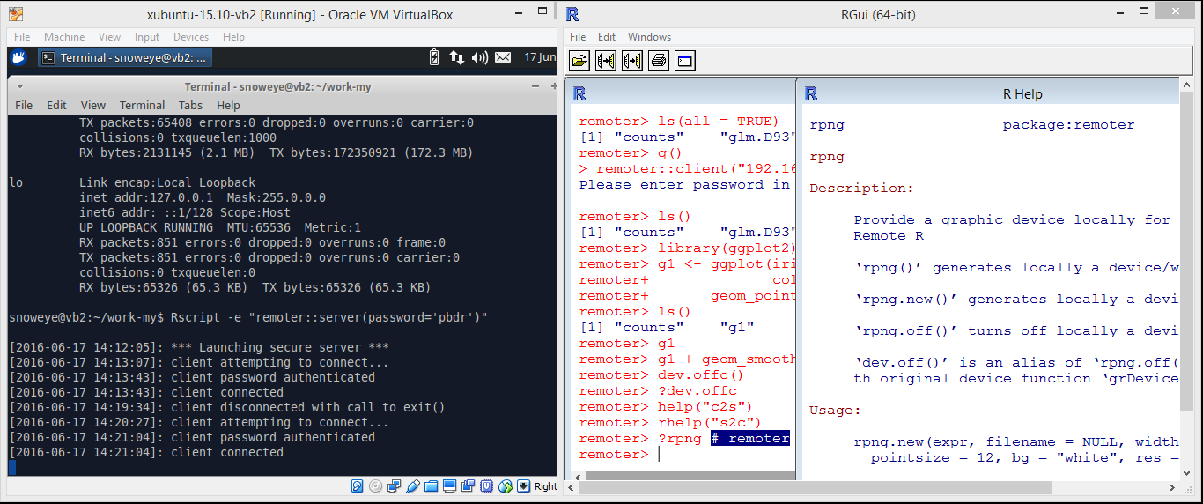
pbdZMQ + remoter
server/remote
receive, execute, and return client’s commands
log message is disabled
client/local
how does the remoter graphic device work?
up/down keys to get history commands

Slide 33
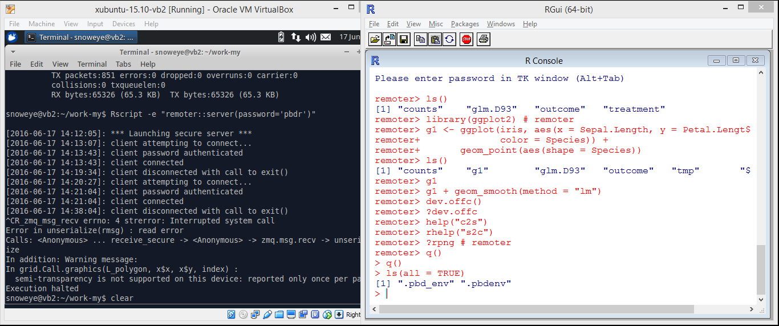
pbdZMQ + remoter
server/remote
ctrl+c to kill the server
client/local
nothing is at local really …
use `q()` to quit or `shutdown()` to kill the server

Slide 34
Introduction

Slide 35
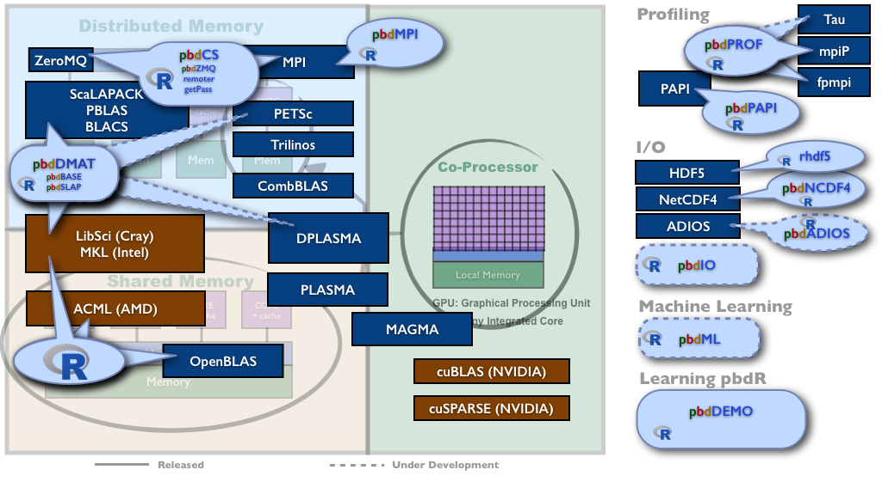
pbdR Project Brings HPC to R
Notes:
The pbdR project is about bringing HPC research to R, adding what is missing, and making it all work together seamlessly.
There are components for computing, for I/O, for profiling, and for machine learning.

Slide 36
pbdR Project Brings HPC to R
Notes:
In this talk we focus on the client/server access to all the HPC power. How to control a thousand cooperating R sessions from one R session.

Slide 37
Advantages of pbdR Client/Server
No need to
setup X11 nor forwarding
know httpd nor html nor htt* whatever
know js nor json nor java nor j* whatever
open any web browser
worry about how to send or receive commands, different data, files, outputs, figures, or helps
worry if a client/local/laptop has enough memory

Slide 38
Limitations of pbdR Client/Server
Too simple, you must speak R …
Too bad, you still need to understand
Single Program Multiple Data
(SPMD) …

Slide 39
Some Good News
Allow to
run most R packages (almost nothing change nor re- implementation)
run on major OSs (including Solaris and Windows)
run across different systems (as long as the same bits)
plugin out-of-core or distributed backend to servers
ff, bigmenory, sparkR, ddR, hadoop, …
database, sql, dbi, …
web services
password protected (masked as well)
encrypted communication (good data policy)
be accessed by multiple users (like MUD or BBS)

Slide 40
Current Designs
pbdR Client/Server
Client/Server Framework
Communication
pbdZMQ
pbdCS
Computation Backend
remoter
pbdDMAT
Security
sodium
getPass
pbdMPI
Reference: Schmidt, Chen, and Ostrouchov (XSEDE2016)

Slide 41
pbdR Client/Server Frameworks
One pbdR client and one pbdR server
pbdZMQ + remoter (+ getPass + sodium)
Note sodium is not part of pbdR, but greatly improve security of communication
One pbdR client and pbdR clusters in SPMD
pbdZMQ + remoter + pbdCS + pbdR’s packages

Slide 42
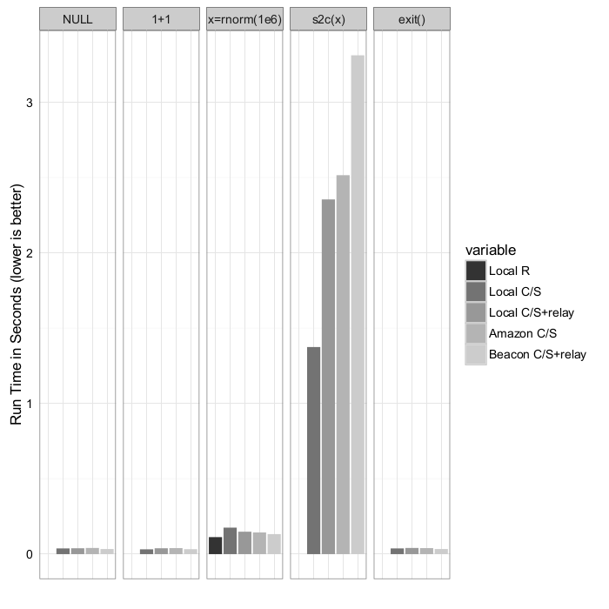
Benchmarks
Wall-clock time measurement of some simple operations, demonstrating the costs. Reference: Schmidt, Chen, and Ostrouchov (XSEDE2016)

Slide 43
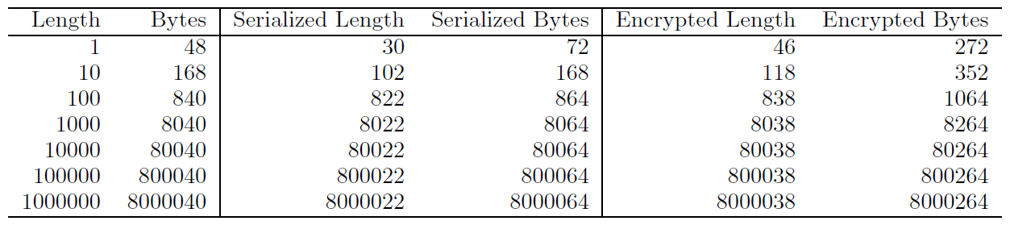
Benchmarks
The overhead of serializing and additionally encrypting a vector of double precision numbers of given length. Reference: Schmidt, Chen, and Ostrouchov (XSEDE2016)

Slide 44
Implementations for HPC

Slide 45
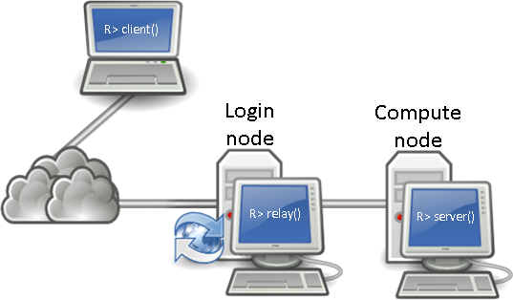
pbdCS on Supercomputers
High Performance Computing (HPC) Resource
Supercomputer (XSEDE)
Google Compute Engine
Amazon EC2
Homemade clusters
Mobile Device
Reference: Schmidt, Chen, and Ostrouchov (XSEDE2016)

Slide 46
Main Concepts
Everything is on server/remote
Global and distributed by default
Nothing is in client/local except necessary communication and interaction
SPMD batch scripts can be run/sourced interactively in client/server framework
``Distributed Read, Compute, Statistics, and Output ...''

Slide 47
A SPMD Example
Input: allreduce(1)
MPI Rank 0
Client
“allreduce(1)”
Request
Reply
Push
Return: 3
3
allreduce(1)
“allreduce(1)”
MPI Rank 1
“allreduce(1)”
Input: allreduce(1)
Client transmits message to server
Messaging server broadcasts message to other SPMD servers
SPMD servers execute command
Messaging server returns result to client
Output: 3
Pull
allreduce(1)
MPI Rank 2
Pull
Reference: Schmidt, Chen, and Ostrouchov (XSEDE2016)
allreduce(1)

Slide 48
Demonstrations of pbdR clusters https://github.com/snoweye/user2016.demo

Slide 49
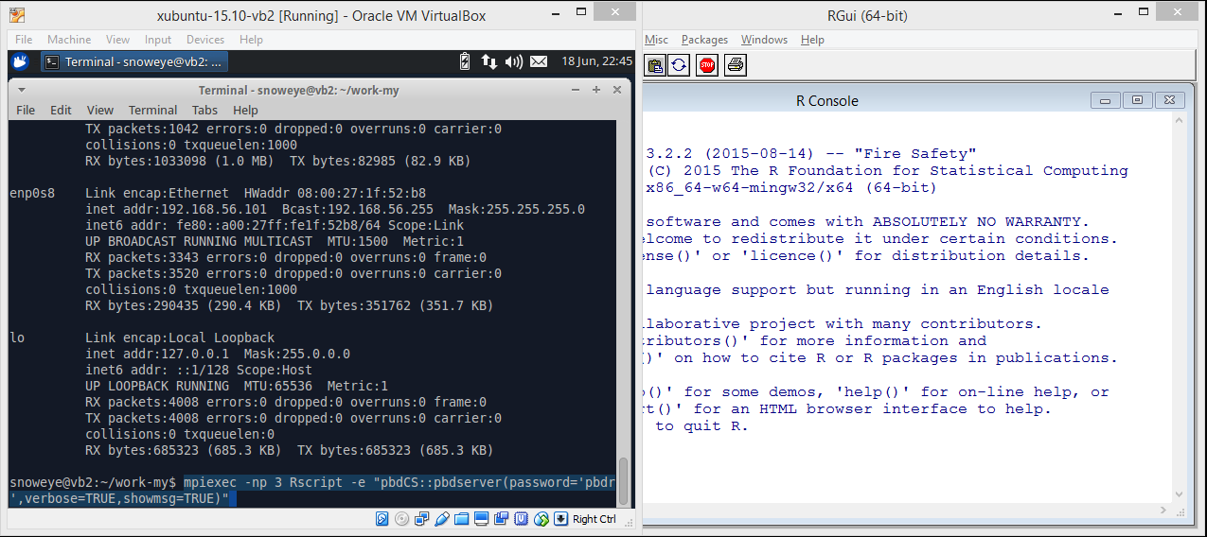
pbdCS + pbdMPI + pbdDMAT
server/remote/MPI clusters
run MPI in 3 jobs
each job runs a Rscript
each Rscript has a `pbdCS::pbdserver()`
client/local
do nothing

Slide 50
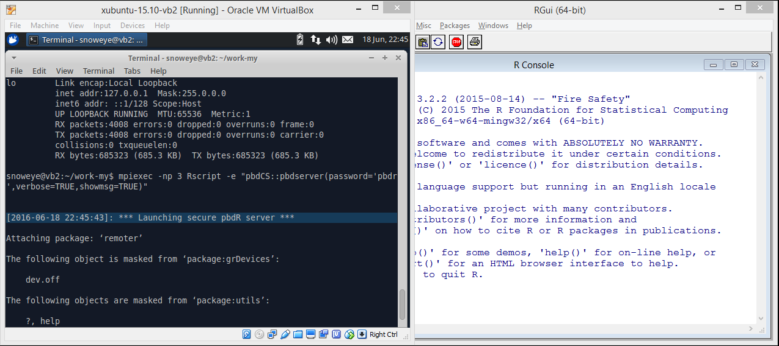
pbdCS + pbdMPI + pbdDMAT
server/remote/MPI clusters
server is on
with messages
client/local
do nothing

Slide 51
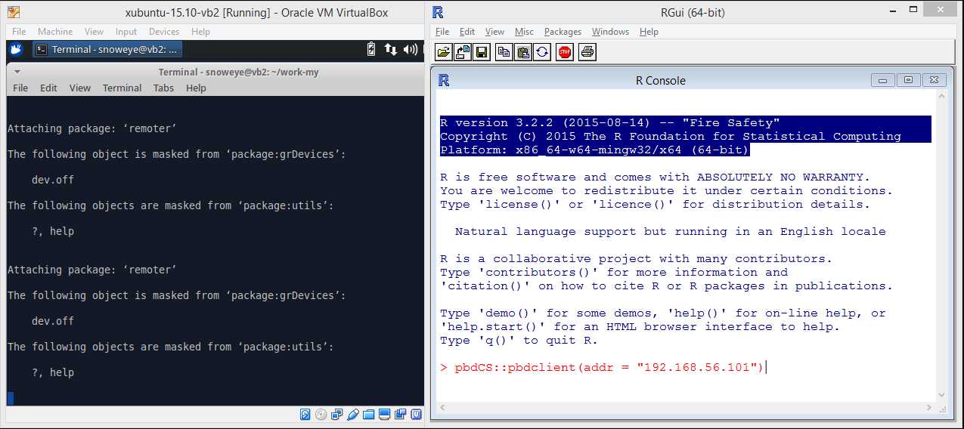
pbdCS + pbdMPI + pbdDMAT
server/remote/MPI clusters
wait for client
client/local
launch a `pbdCS::pbdclient()`

Slide 52
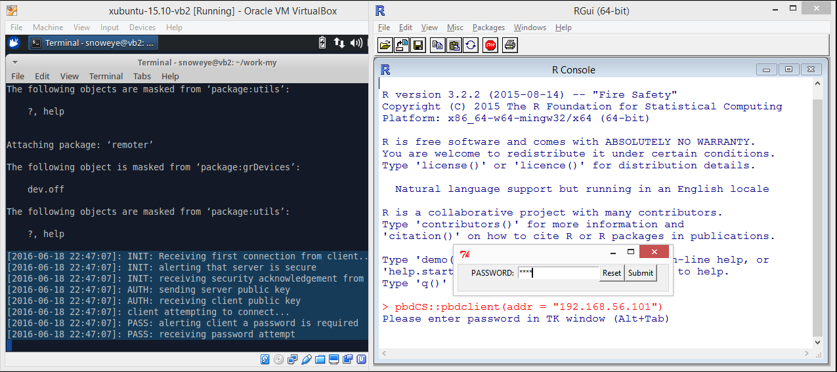
pbdCS + pbdMPI + pbdDMAT
server/remote/MPI clusters
wait for password
client/local
enter password

Slide 53
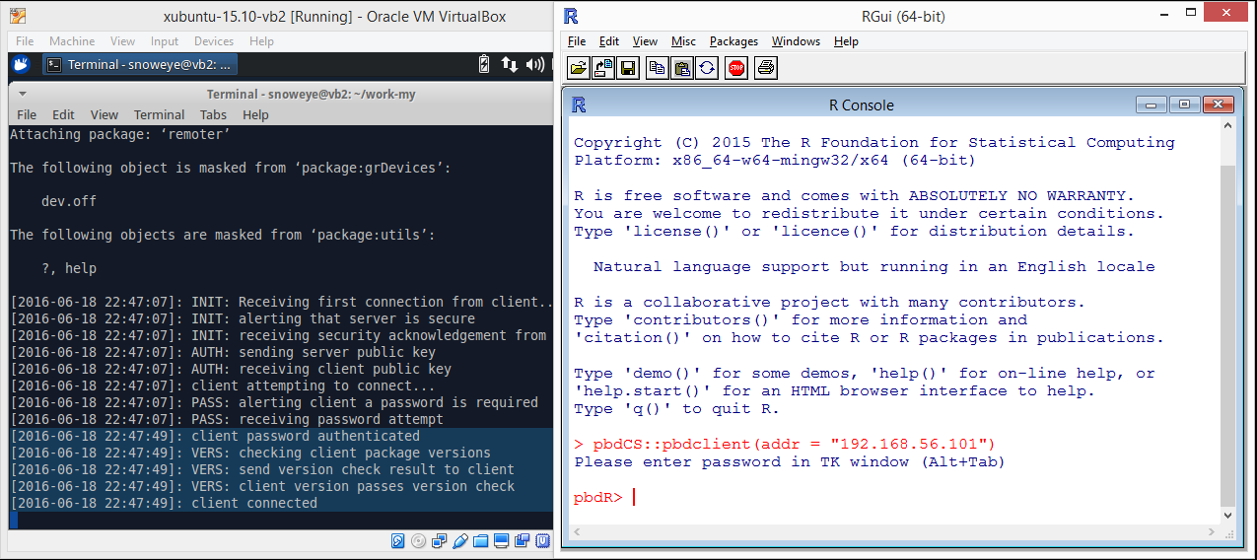
pbdCS + pbdMPI + pbdDMAT
server/remote/MPI clusters
check password
client/local
connect to server

Slide 54
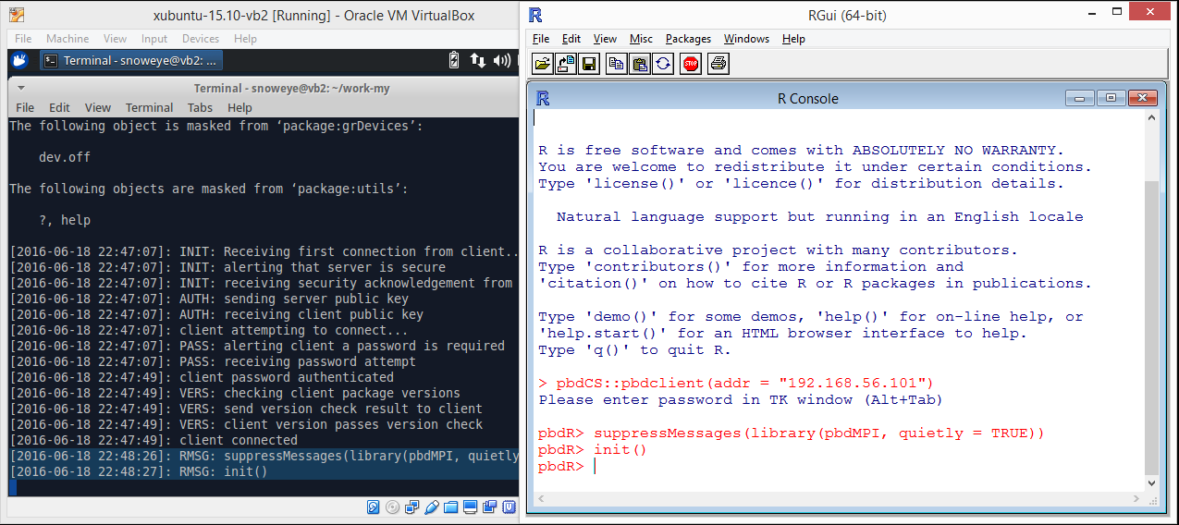
pbdCS + pbdMPI + pbdDMAT
server/remote/MPI clusters
load pbdMPI
initial MPI communicator
see pbdMPI vignette
client/local
ask server to load pbdMPI
ask server to initial MPI communicator

Slide 55
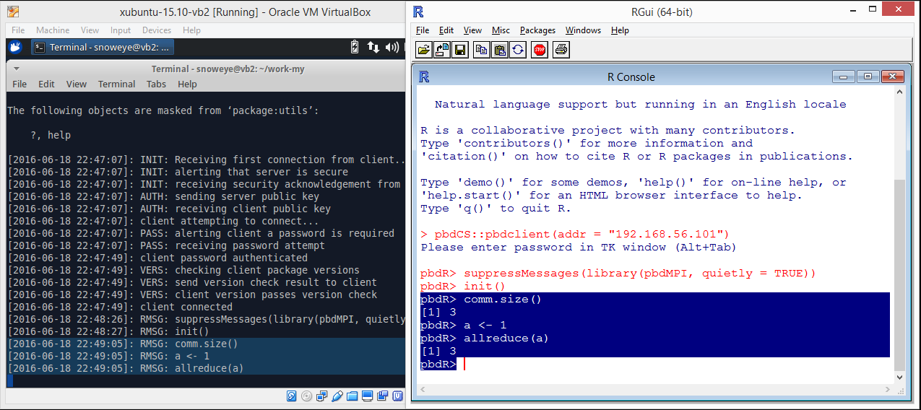
pbdCS + pbdMPI + pbdDMAT
server/remote/MPI clusters
receive commands from client
client/local
check comm size (3 ranks)
do a default `allreduce()` to sum over all ranks (every rank has `a=3`)

Slide 56
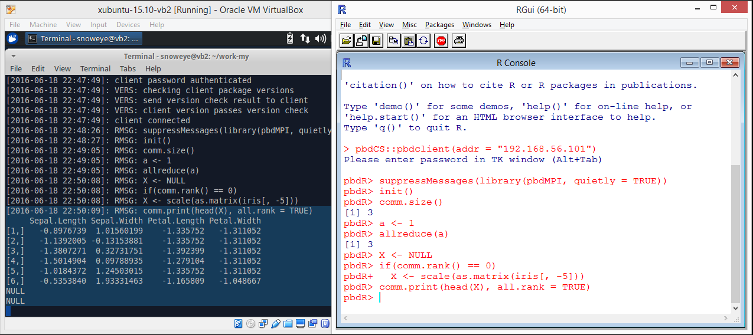
pbdCS + pbdMPI + pbdDMAT
server/remote/MPI clusters
only rank 0 has `iris`
client/local
standardized `iris
`comm.print()` prints to server as behave in batch mode

Slide 57
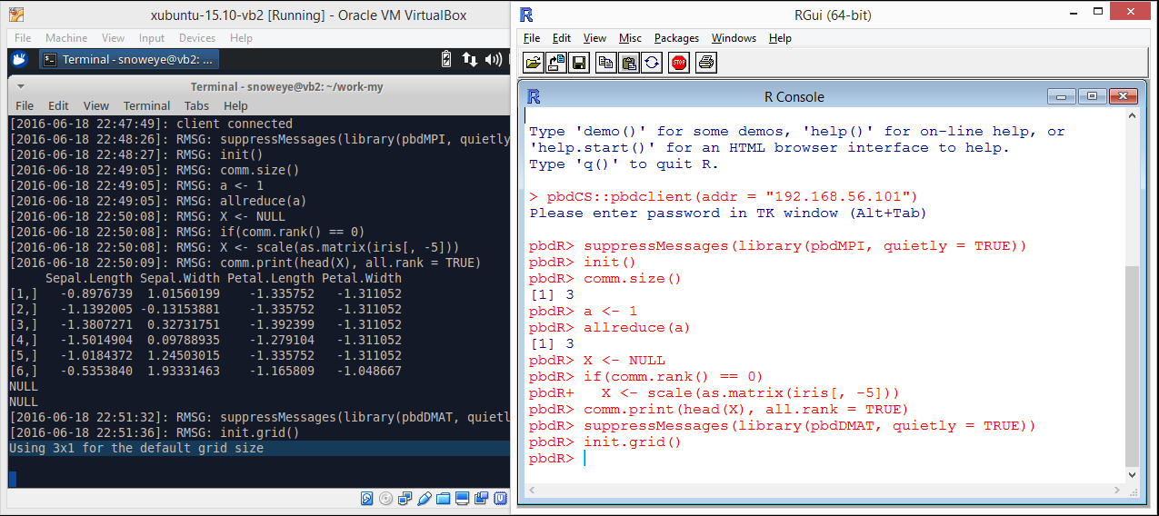
pbdCS + pbdMPI + pbdDMAT
server/remote/MPI clusters
3x1 grid is formed
client/local
load `pbdDMAT`
initial grid for block-cyclic
see pbdDEMO vignette

Slide 58
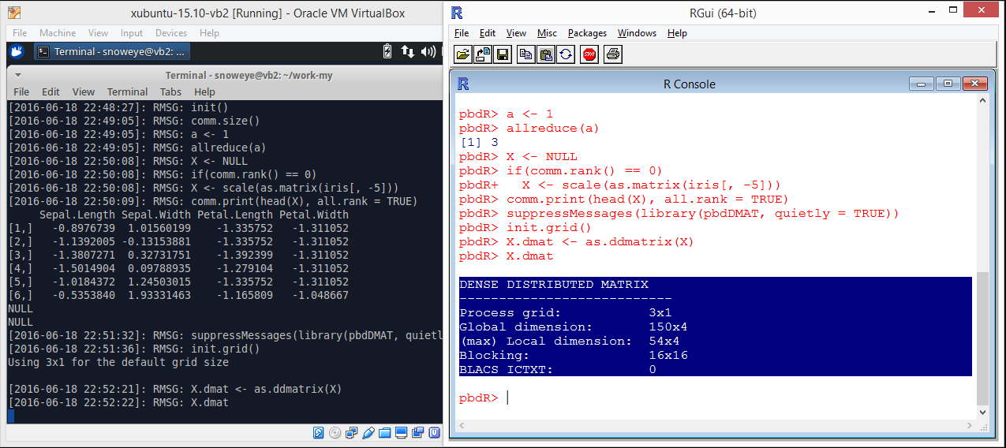
pbdCS + pbdMPI + pbdDMAT
server/remote/MPI clusters
receive client commands
client/local
convert data to a `ddmatrix`
`print.ddmatrix()` casts summary to local

Slide 59
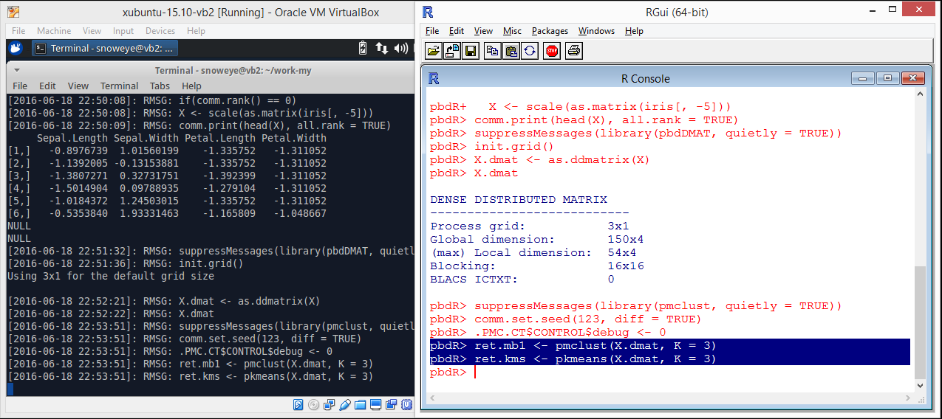
pbdCS + pbdMPI + pbdDMAT
server/remote/MPI clusters
receive more client commands
client/local
load `pmclust` for clustering distributed data
see Chen, et.al. (2013) Technometrics

Slide 60
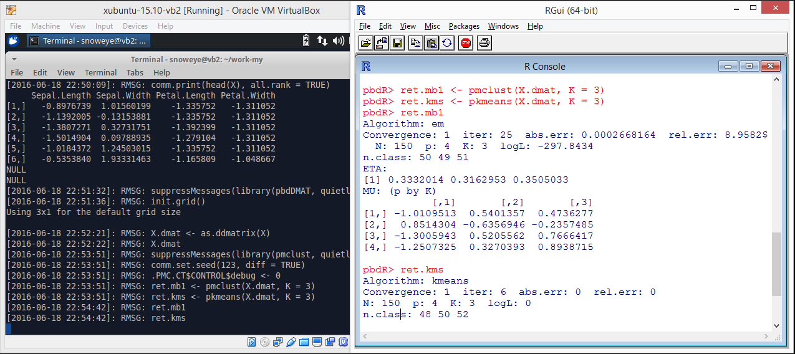
pbdCS + pbdMPI + pbdDMAT
server/remote/MPI clusters
receive more client commands
client/local
summary clustering results

Slide 61
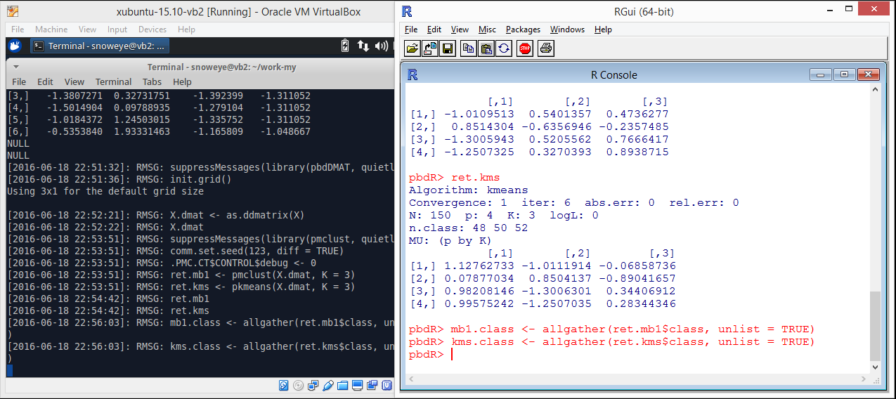
pbdCS + pbdMPI + pbdDMAT
server/remote/MPI clusters
receive more client commands
client/local
`allgather()` all clustering ids from all ranks to every ranks
`gather()` should be faster

Slide 62
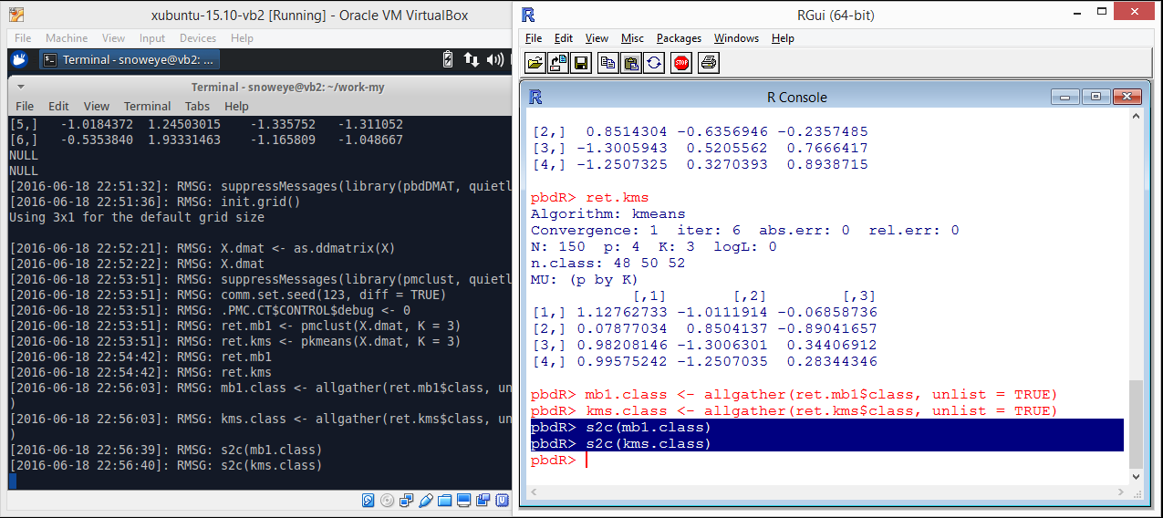
pbdCS + pbdMPI + pbdDMAT
server/remote/MPI clusters
receive more client commands
client/local
copy clustering ids from server (rank 0) to client

Slide 63
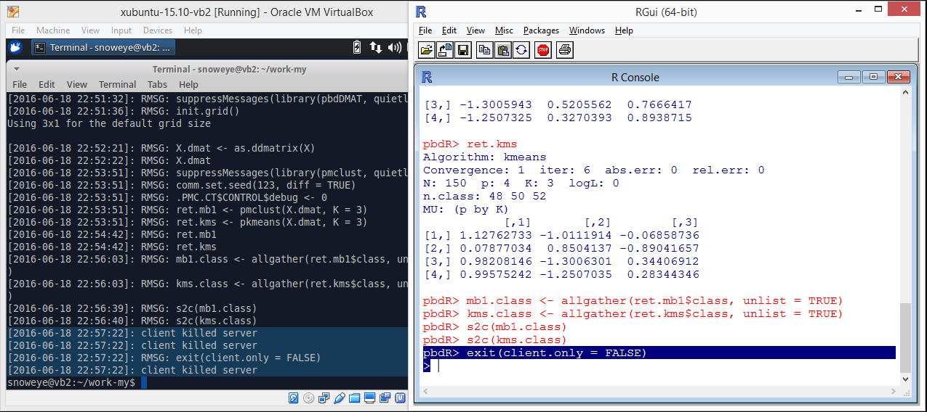
pbdCS + pbdMPI + pbdDMAT
server/remote/MPI clusters
kill server
kill all MPI jobs as well
client/local
exit and kill server and MPI jobs
release resources for other users

Slide 64
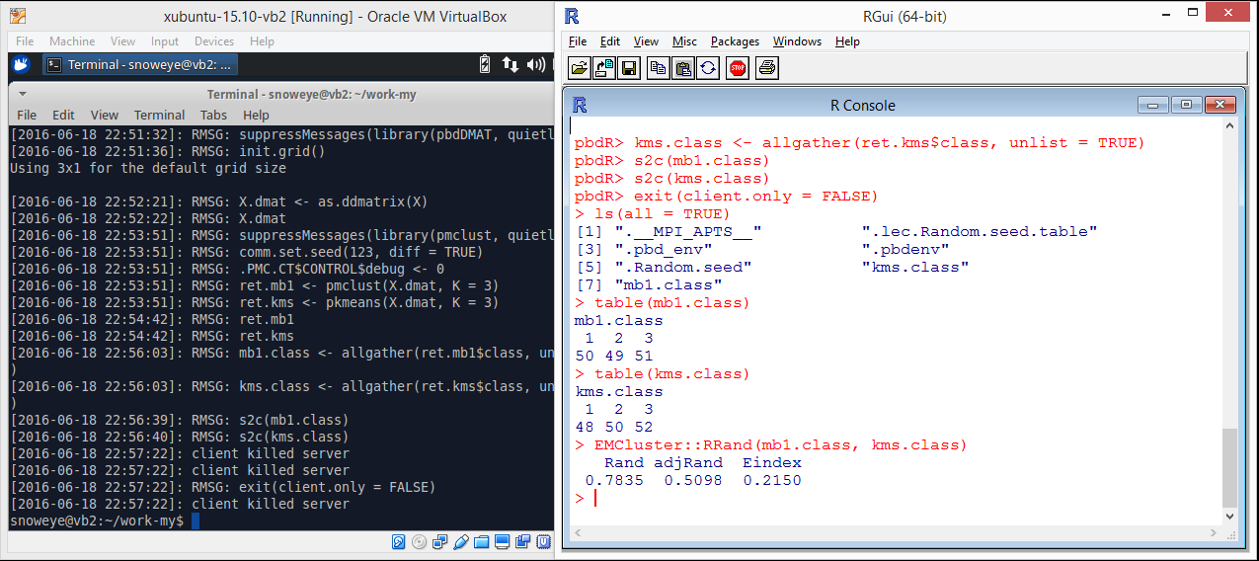
pbdCS + pbdMPI + pbdDMAT
server/remote/MPI clusters
done
client/local
check consistence between model-based results and k-means results

Slide 65
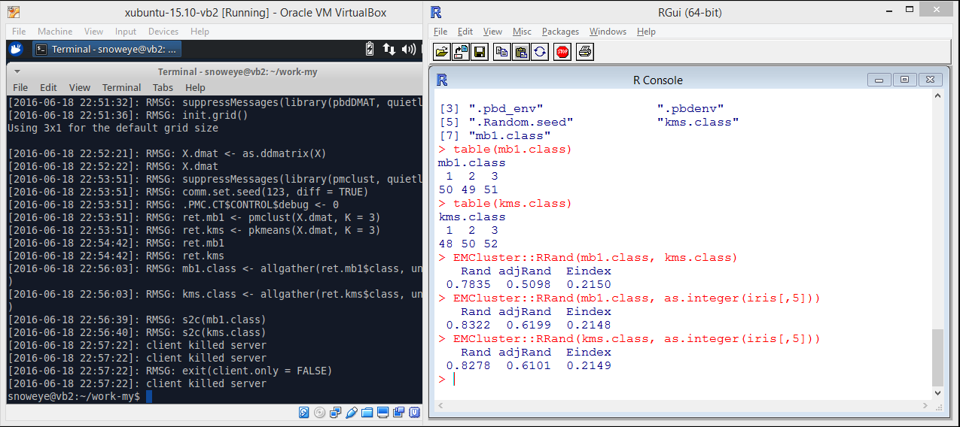
pbdCS + pbdMPI + pbdDMAT
server/remote/MPI clusters
done
client/local
check consistence with true ids of `iris`

Slide 66
Benchmarks
> library(pbdCS)
> pbdclient()
pbdR> library(memuse)
pbdR> howbig(1e7, 1e3)
74.506 GiB
pbdR> comm.size()
[1] 512
pbdR> library(pbdDMAT)
pbdR> init.grid()
pbdR> system.time(x <- ddmatrix("rnorm", 1e7, 1e3))
user system elapsed
6.034 0.022 6.058
pbdR> system.time(xtx <- t(x) %*% x)
user system elapsed
182.744 0.158 182.963
pbdR> system.time(xtx <- crossprod(x))
user system elapsed
11.056 0.551 11.613
pbdR> system.time(x.pca <- prcomp(x))
user system elapsed
152.899 1.419 154.422

Slide 67
Benchmarks
pbdR> library(pbdML)
pbdR> system.time(x.pca <- rpca(x, k=5))
user system elapsed
15.177 0.673 15.922
pbdR> x
DENSE DISTRIBUTED MATRIX
---------------------------
Process grid: 32x16
Global dimension: 10000000x1000
(max) Local dimension: 312512x64
Blocking: 16x16
BLACS ICTXT: 0
pbdR> xtx
DENSE DISTRIBUTED MATRIX
---------------------------
Process grid: 32x16
Global dimension: 1000x1000
(max) Local dimension: 32x64
Blocking: 16x16
BLACS ICTXT: 0
pbdR> names(x.pca)
[1] "sdev" "rotation" "center" "scale" "x"
pbdR> x.pca$sdev
[1] 1.001280 1.000767 1.000654 1.000422 1.000305
pbdR> shutdown()

Slide 68
Discussions

Slide 69
Other Interactive Frameworks
R
rmote (https://github.com/cloudyr/rmote)
shiny
parallel, snow, Rmpi
Python & Jupyter
IRkernel (https://github.com/IRkernel/IRkernel) depending on pbdZMQ as well

Slide 70
Future Directions
could be your application and dream
RBigData@gmail.com
https://github.com/RBigData

Slide 71
References
Schmidt, D., Chen, W.-C. and Ostrouchov, G. (2016), ``Introducing a New Client/Server Framework for Big Data Analytics with the R Language,’’ XSEDE2016.
Chen, W.-C., Ostrouchov, G., Schmidt, D., Patel, P. and Yu, H. (2012), ``A Quick Guide for the pbdMPI Package.’’ R Vignette, URL http://cran.r-project.org/package=pbdMPI
Schmidt, D., Chen, W.-C., Patel, P., and Ostrouchov, G. (2014), ``Speaking Serial R with a Parallel Accent.’’ R Vignette, URL http://cran.r-project.org/package=pbdDEMO
Chen, W.-C., Ostrouchov, G., Pugmire, D., Prahat, and Wehner, M. (2013), ``A Parallel EM Algorithm for Model-Based Clustering Applied to the Exploration of Large Spatio-Temporal Data,’’ Technometrics, 55(4), 513-523.

